Slide 1
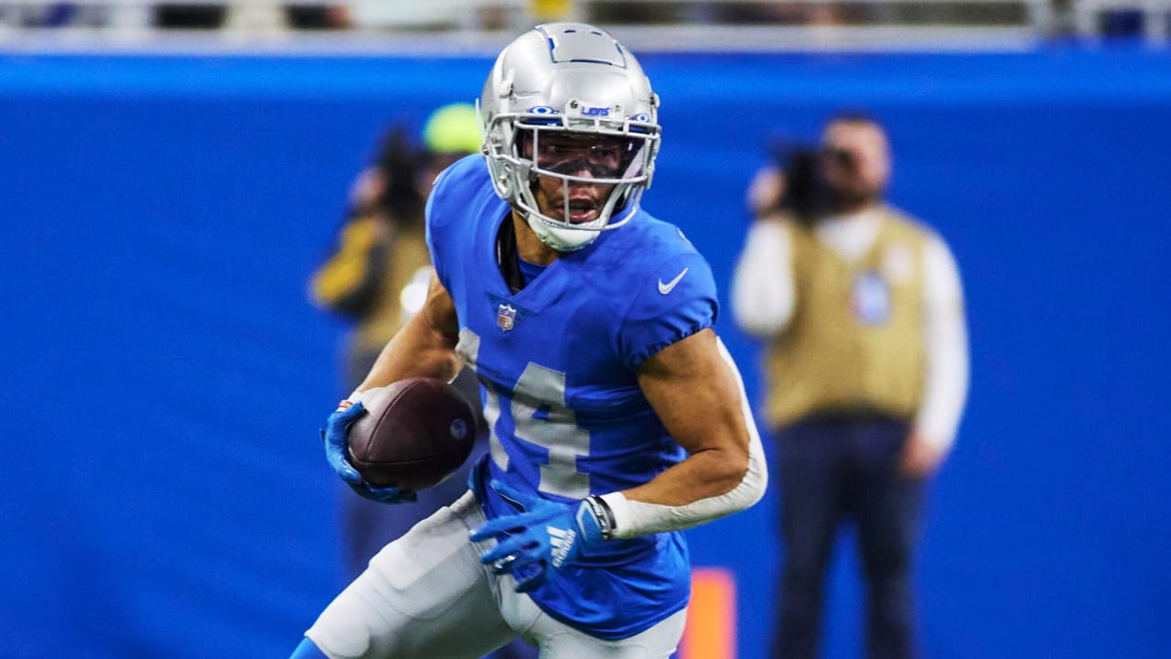


We need Lions!
Proposal for CSR Marketing for Lions
Hult International Business School – Master of Business Analytics
Communication & Collaboration I: Personal Impact
Team 12 [Scifi-2]
Sreekar Bathula, Yunsik Choung, Jing Li, Tangina Parvez

Slide 2
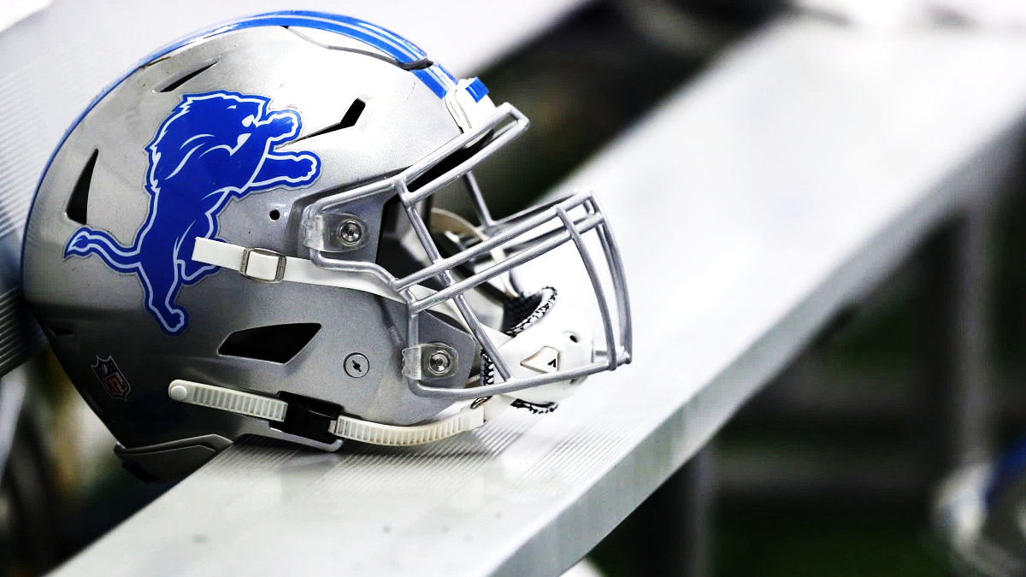

CONTENTS
Introduce About Previous Work between TEP and Lions
Exacerbation after the Pandemic
What do we want to support?
CSR Marketing Strategies
Funding
What will become True?

Slide 3
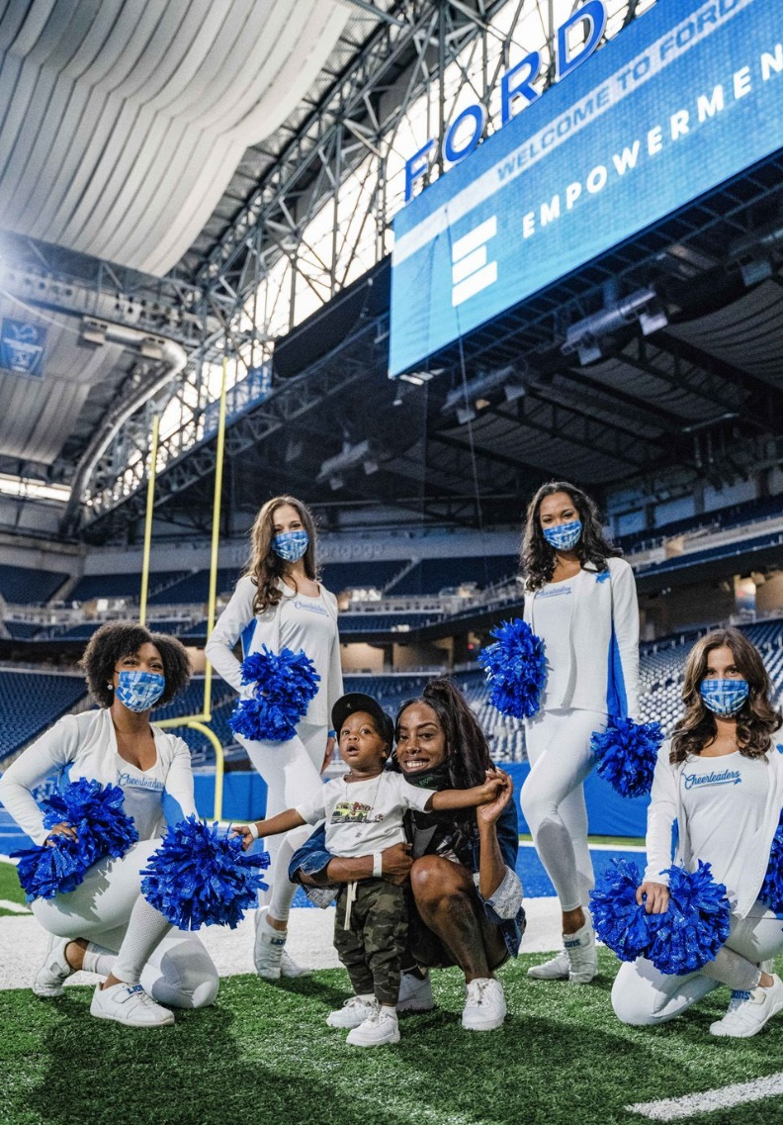
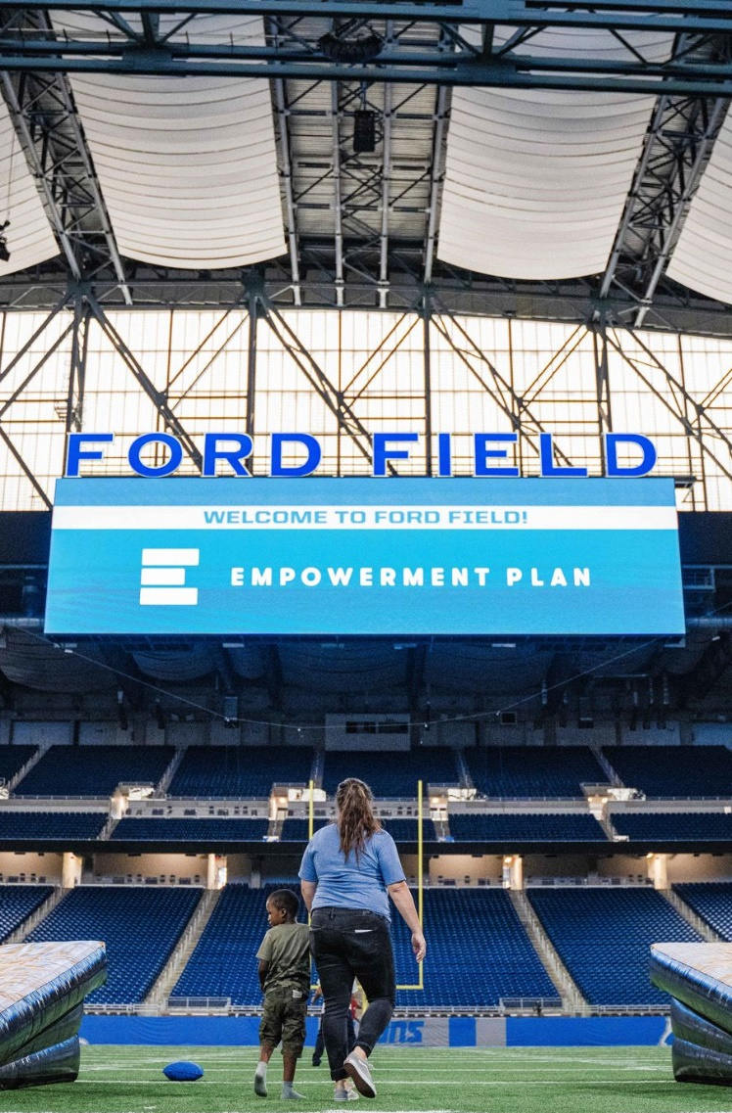
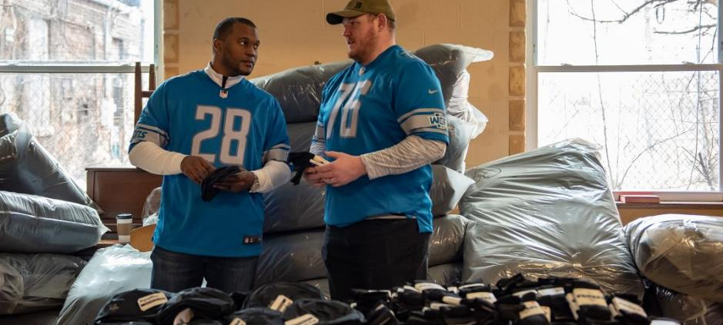
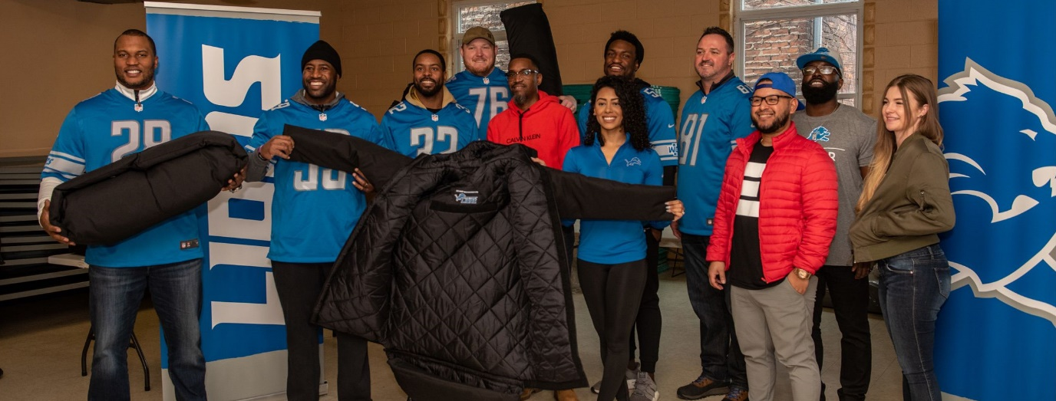
Introduce About Previous Work between TEP and Lions
Empowerment Plan Family Day Photos
Empowerment Plan Coat Distribution
The Empowerment Plan joining Roary and the Detroit Lions Cheerleaders for a day of fun and games at Ford Field.
Lions Legends and players distributed sleeping bag coats to Detroiters experiencing homelessness in partnership with the Empowerment Plan.

Slide 4
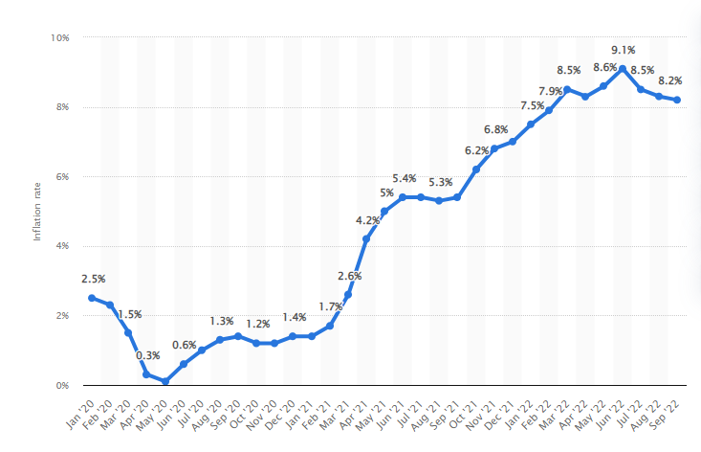
Exacerbation after the Pandemic
Inflation arose from COVID-19 and Re-increasing Homeless People in Detroit
Monthly 12-month inflation rate in the United States from January 2020 to September 2022
Annual Homeless Statistics and Increase rate in Detroit
To Overcome this, We need to continue of a process for donation
for contribution to society and help homeless people

Slide 5

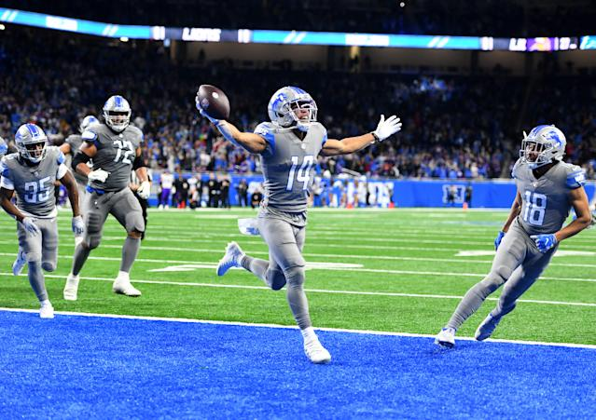

What do we want to support?
From temporary sponsorship to Regular sponsorship
HOW
To increase size of sponsorship
By relating Lions game records
Using Charity Match
Partnership and Marketing Coordination
WHY
To increase size of sponsorship
For Building Social Brand image
For Spreading hope to neighbors
For fame, social responsibility

Slide 6

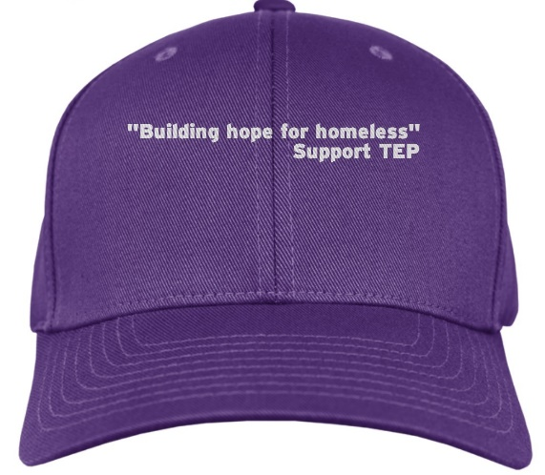
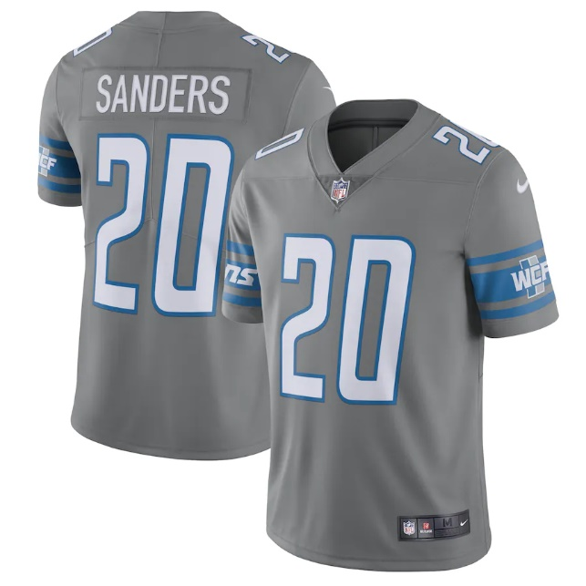
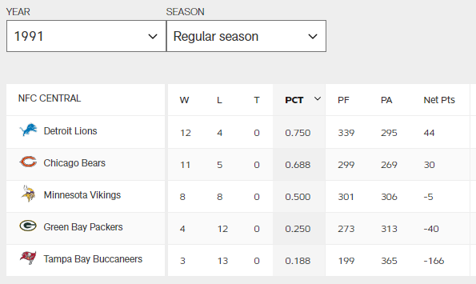
CSR Marketing Strategies
1
2
3
Distribute Coats Relating
Team Records
Wearing caps or ribbon
For Purple Color
Play with purple jersey
1 match in a league
1 Point = 1 Coat
1 Win = 10 Extra Coats
Text with
Building hope for the homeless
Support TEP
Stand for Homeless with Lions
In 1991, Total 339 PF for 339 Coats
12 Wins for 120 Coats
We can make 459 Coats

Slide 7
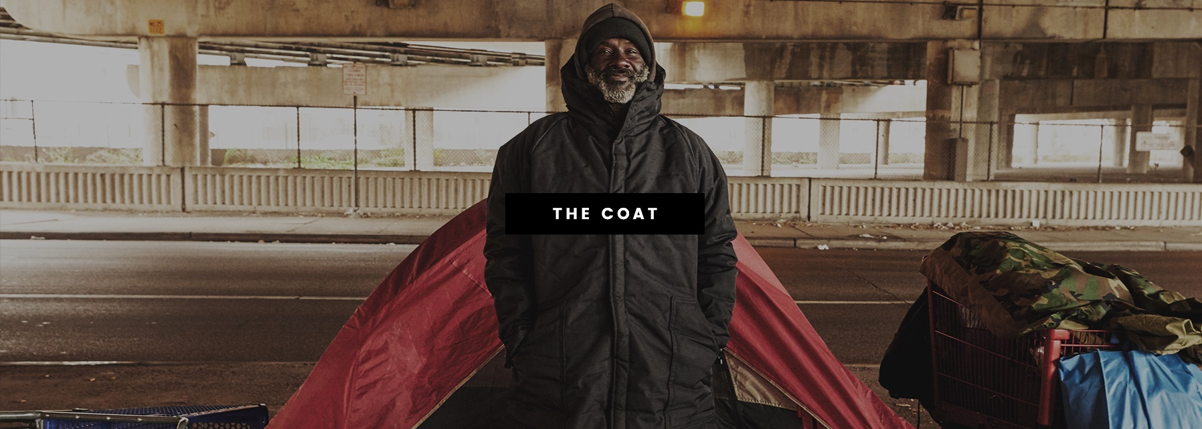
Funding
Based on 1991 Records
459 Coats X $150
$ 68,850 per Year

Slide 8
What will become True?
More coat distribution for preventing winter
Encourage people to help homeless neighbor
Make more stable job opportunities in Detroit

Slide 9

What will become True?
Plan based
Good Cause
Act for
Sustainable Values
Helping to solve the problems
of Detroit
Regular supporting to Detroit homeless people
CSR
Marketing
The Fame of Social Responsibility build trust with Lions Fans
Engage with Empowerment Plan and give hope to local community
Build trust in
Sincere Responsibility
Collaborate with
Local Community

Slide 10
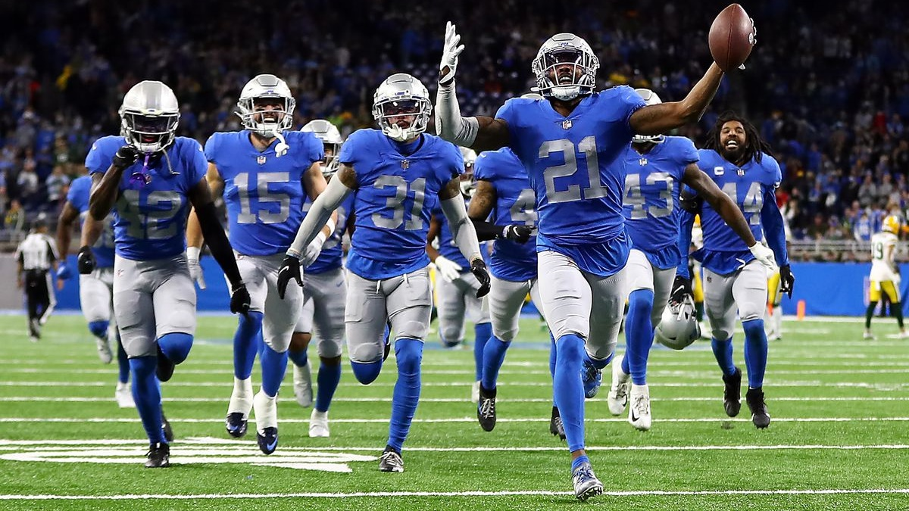
Thank You Lions

